Slide 1

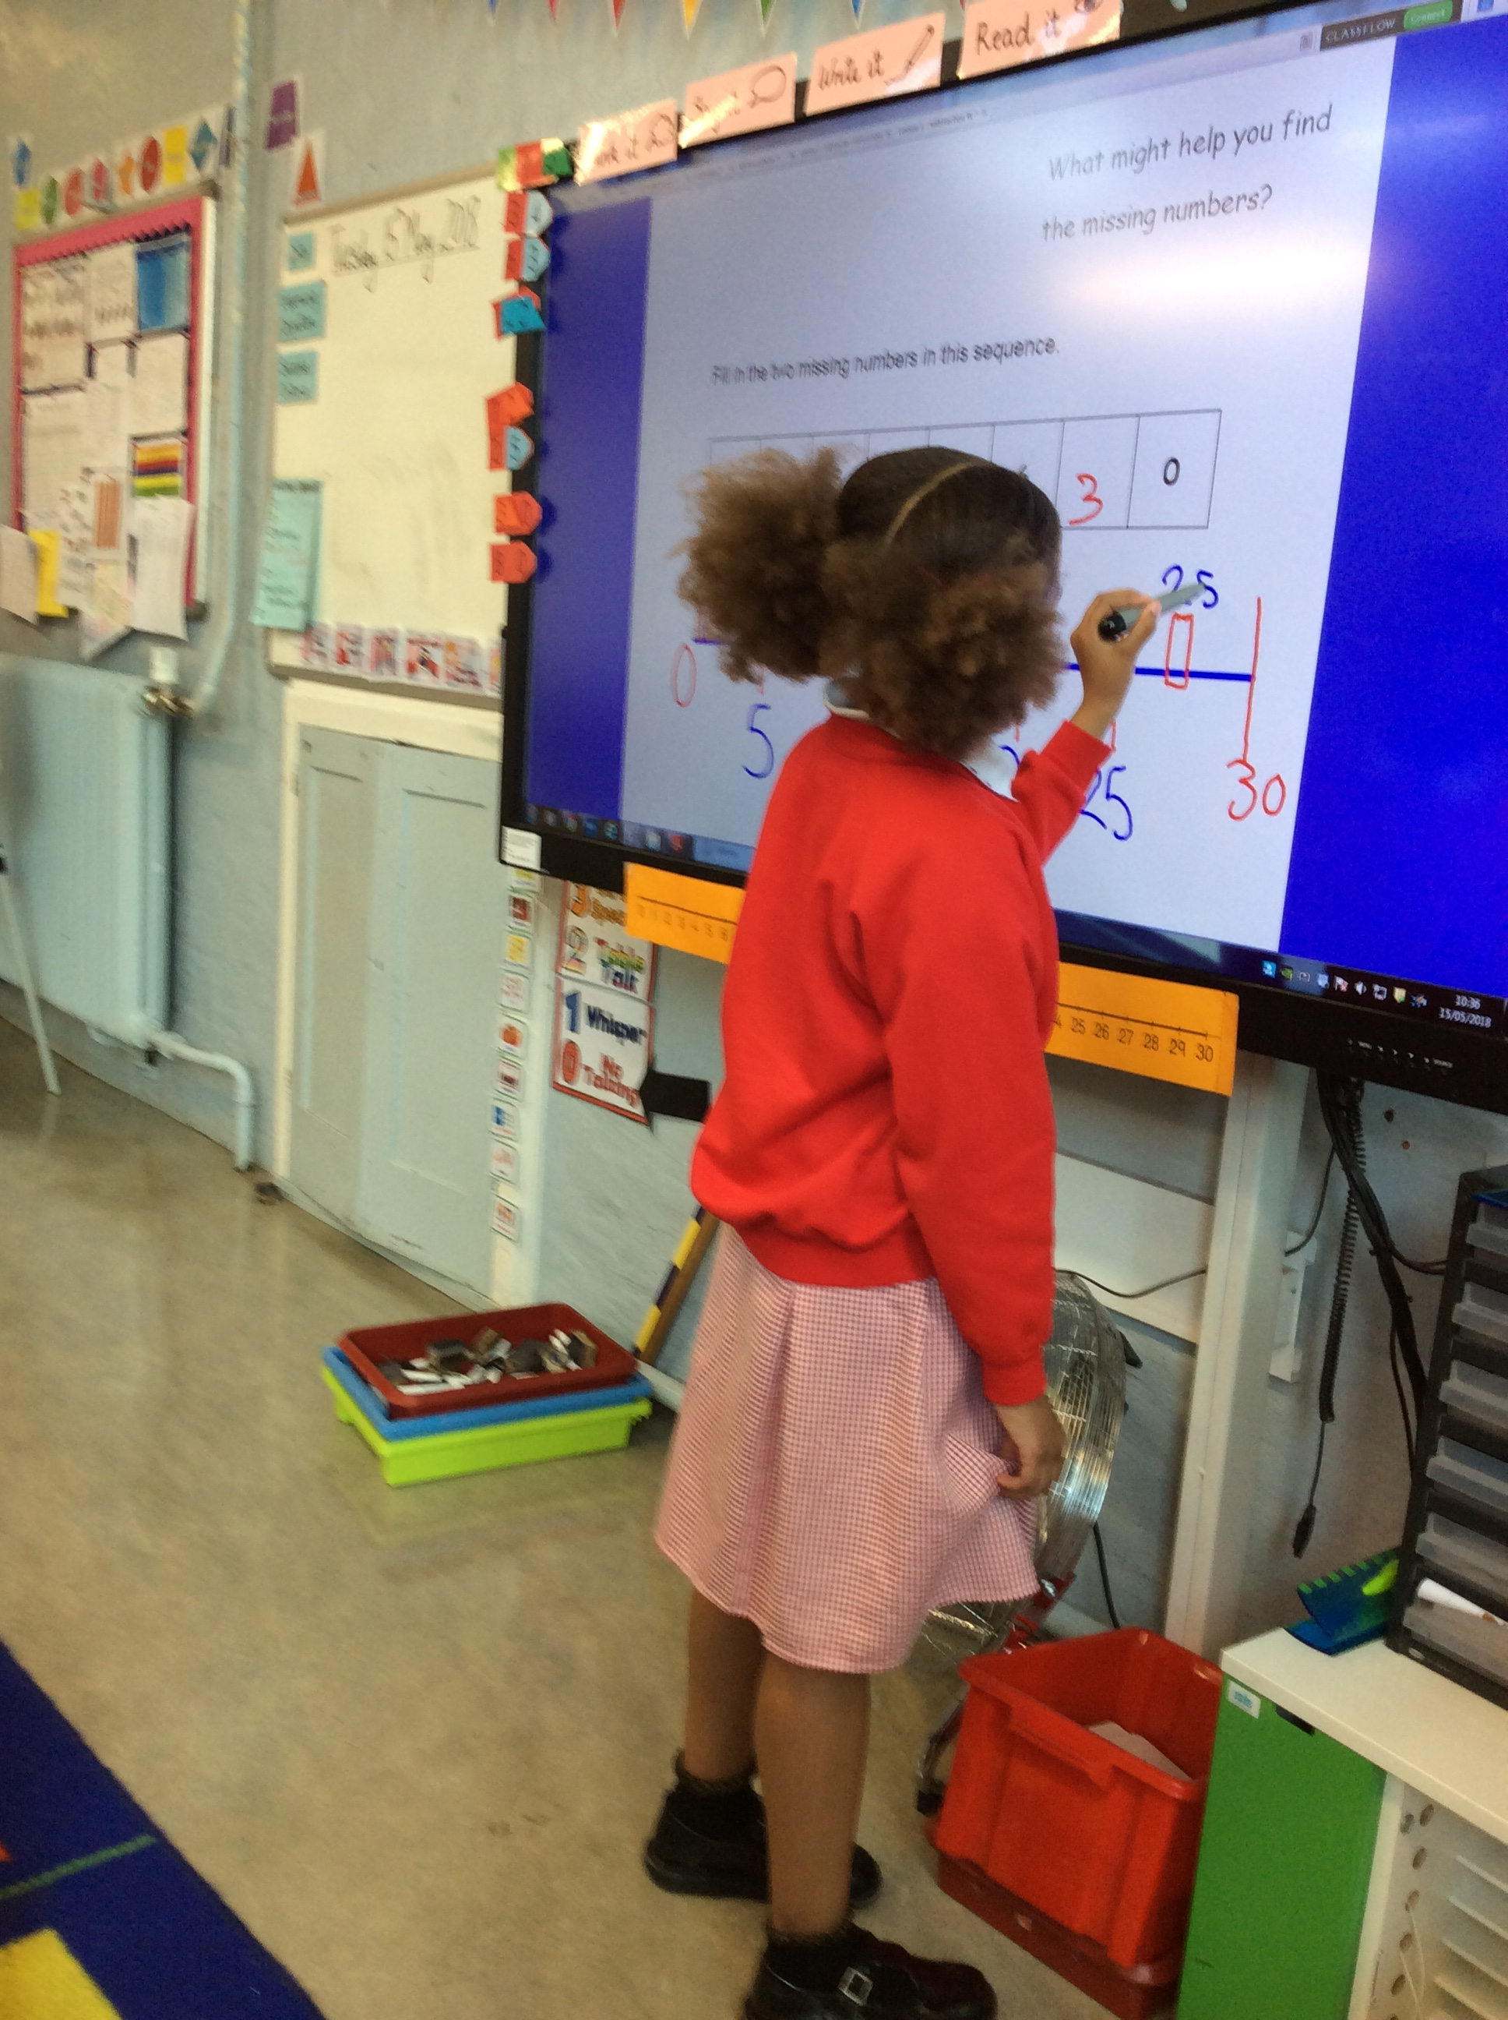
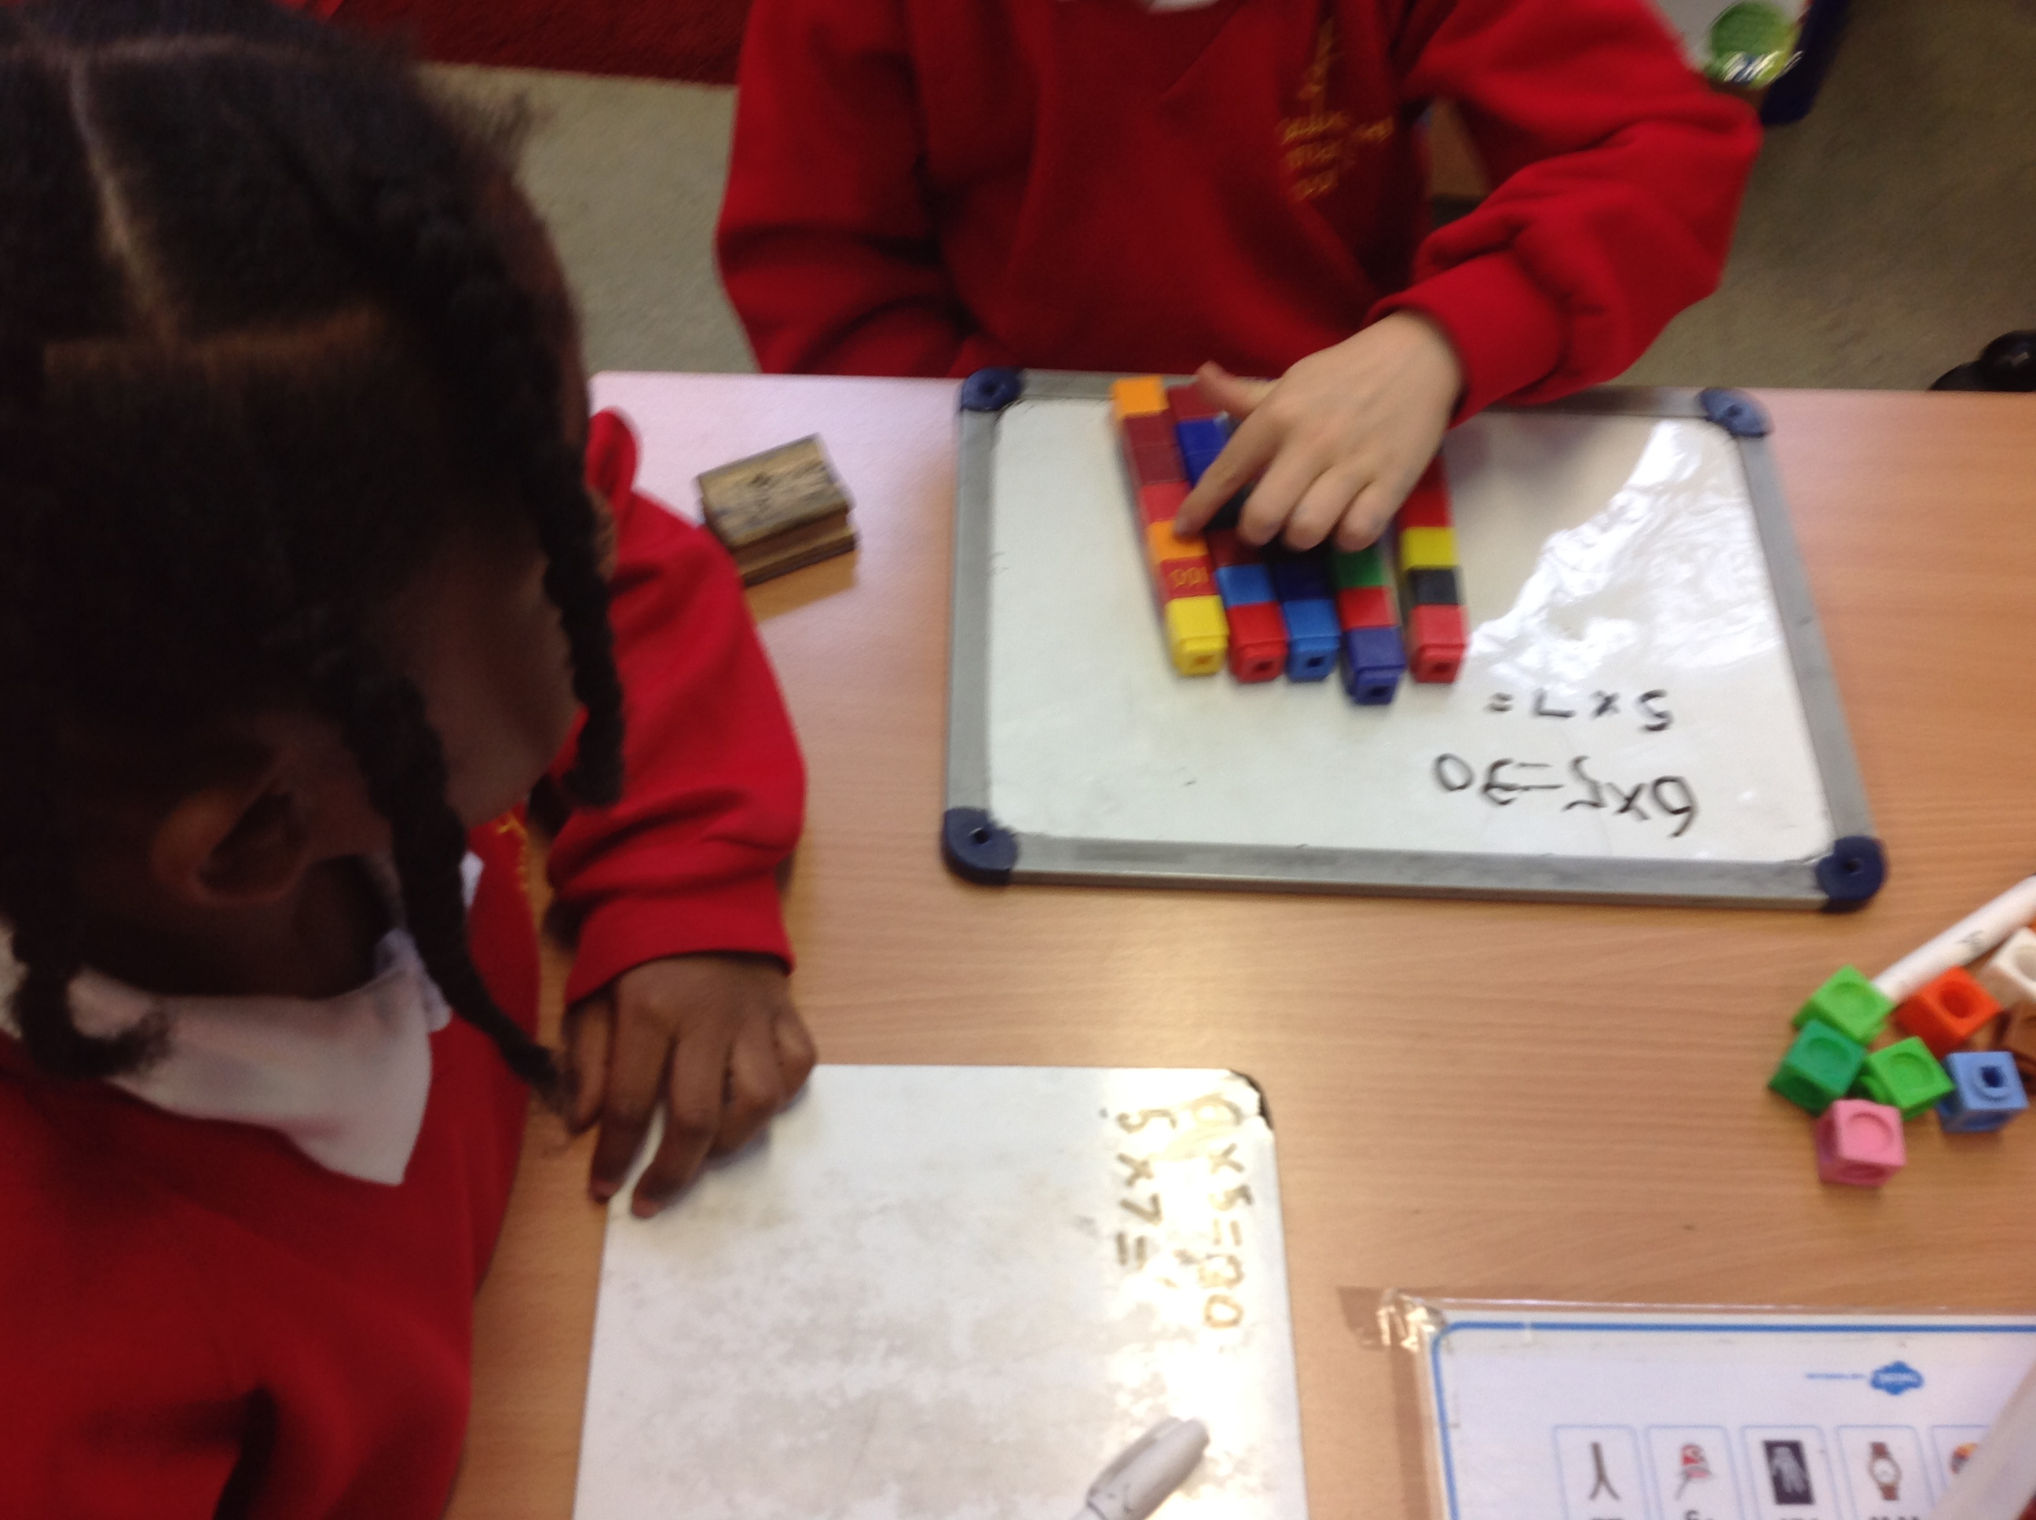
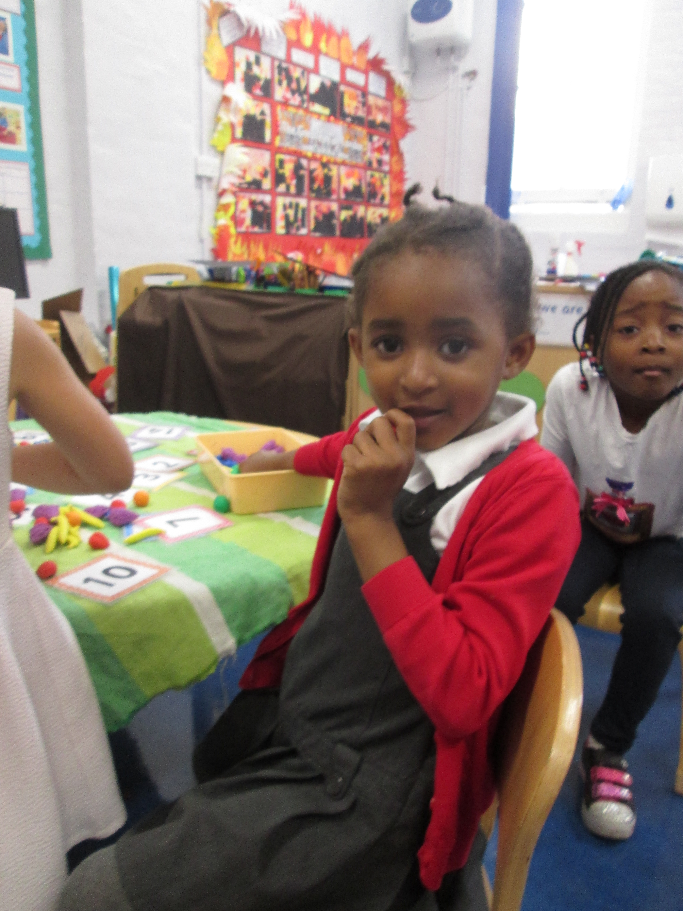
Welcome To our
Maths Family workshop
PRESENTERS: CHERYL GUSTAVE & SEEMA BIBI
Wednesday 26th September 2018

Slide 2
AIMS FOR THIS WORKSHOP
To get an insight into how Maths is taught in KS1 at Daubeney.
To discuss strategies that you can use to support your child at home.
To discuss how MATHS is a part of our everyday life.
To develop strategies that can support your child to develop KEY MATHS skills as part of their home learning.
To develop the understanding that MATHS can be fun.

Slide 3



Numbers
Shape, space and measure

Slide 4
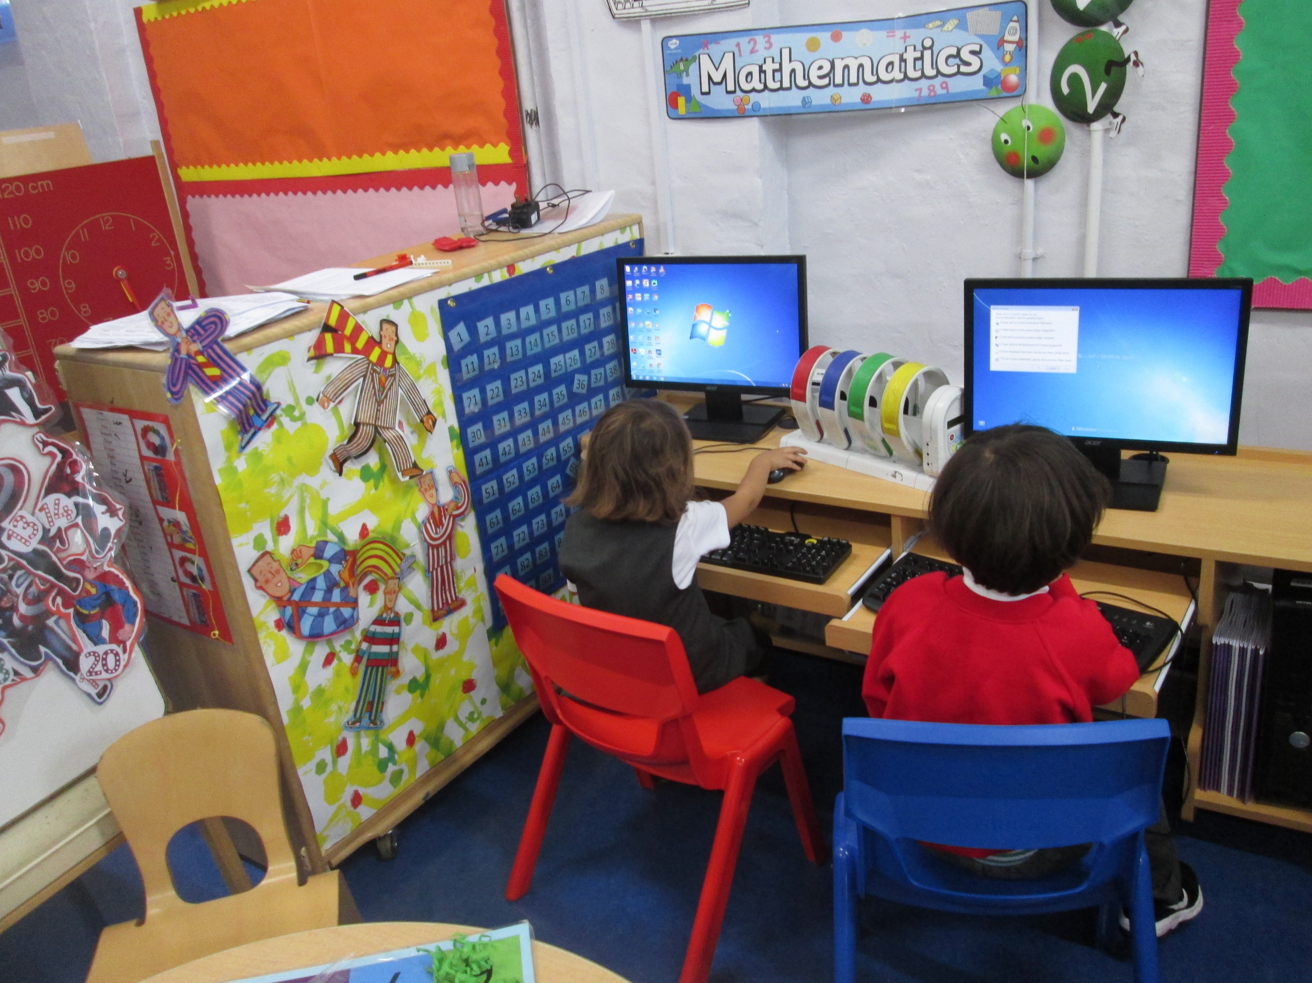
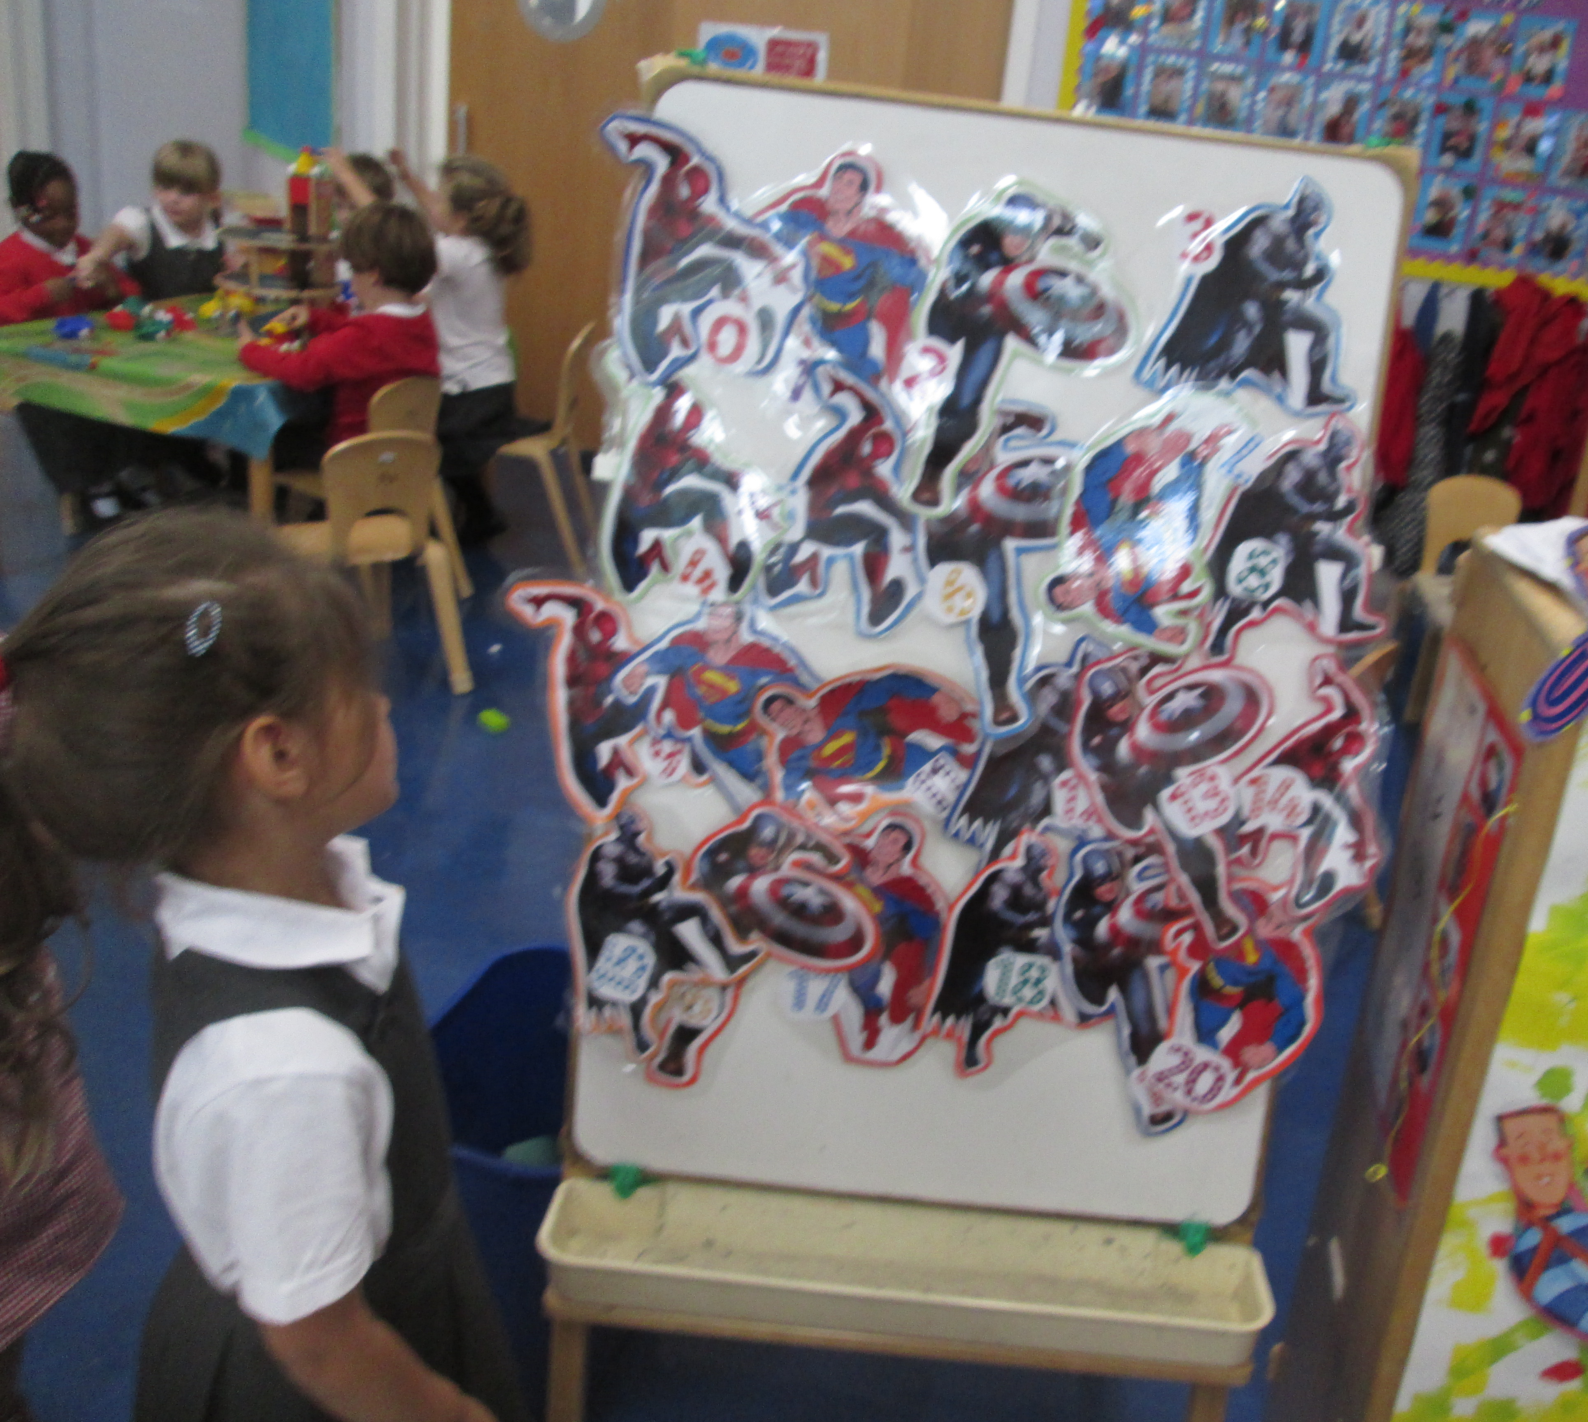
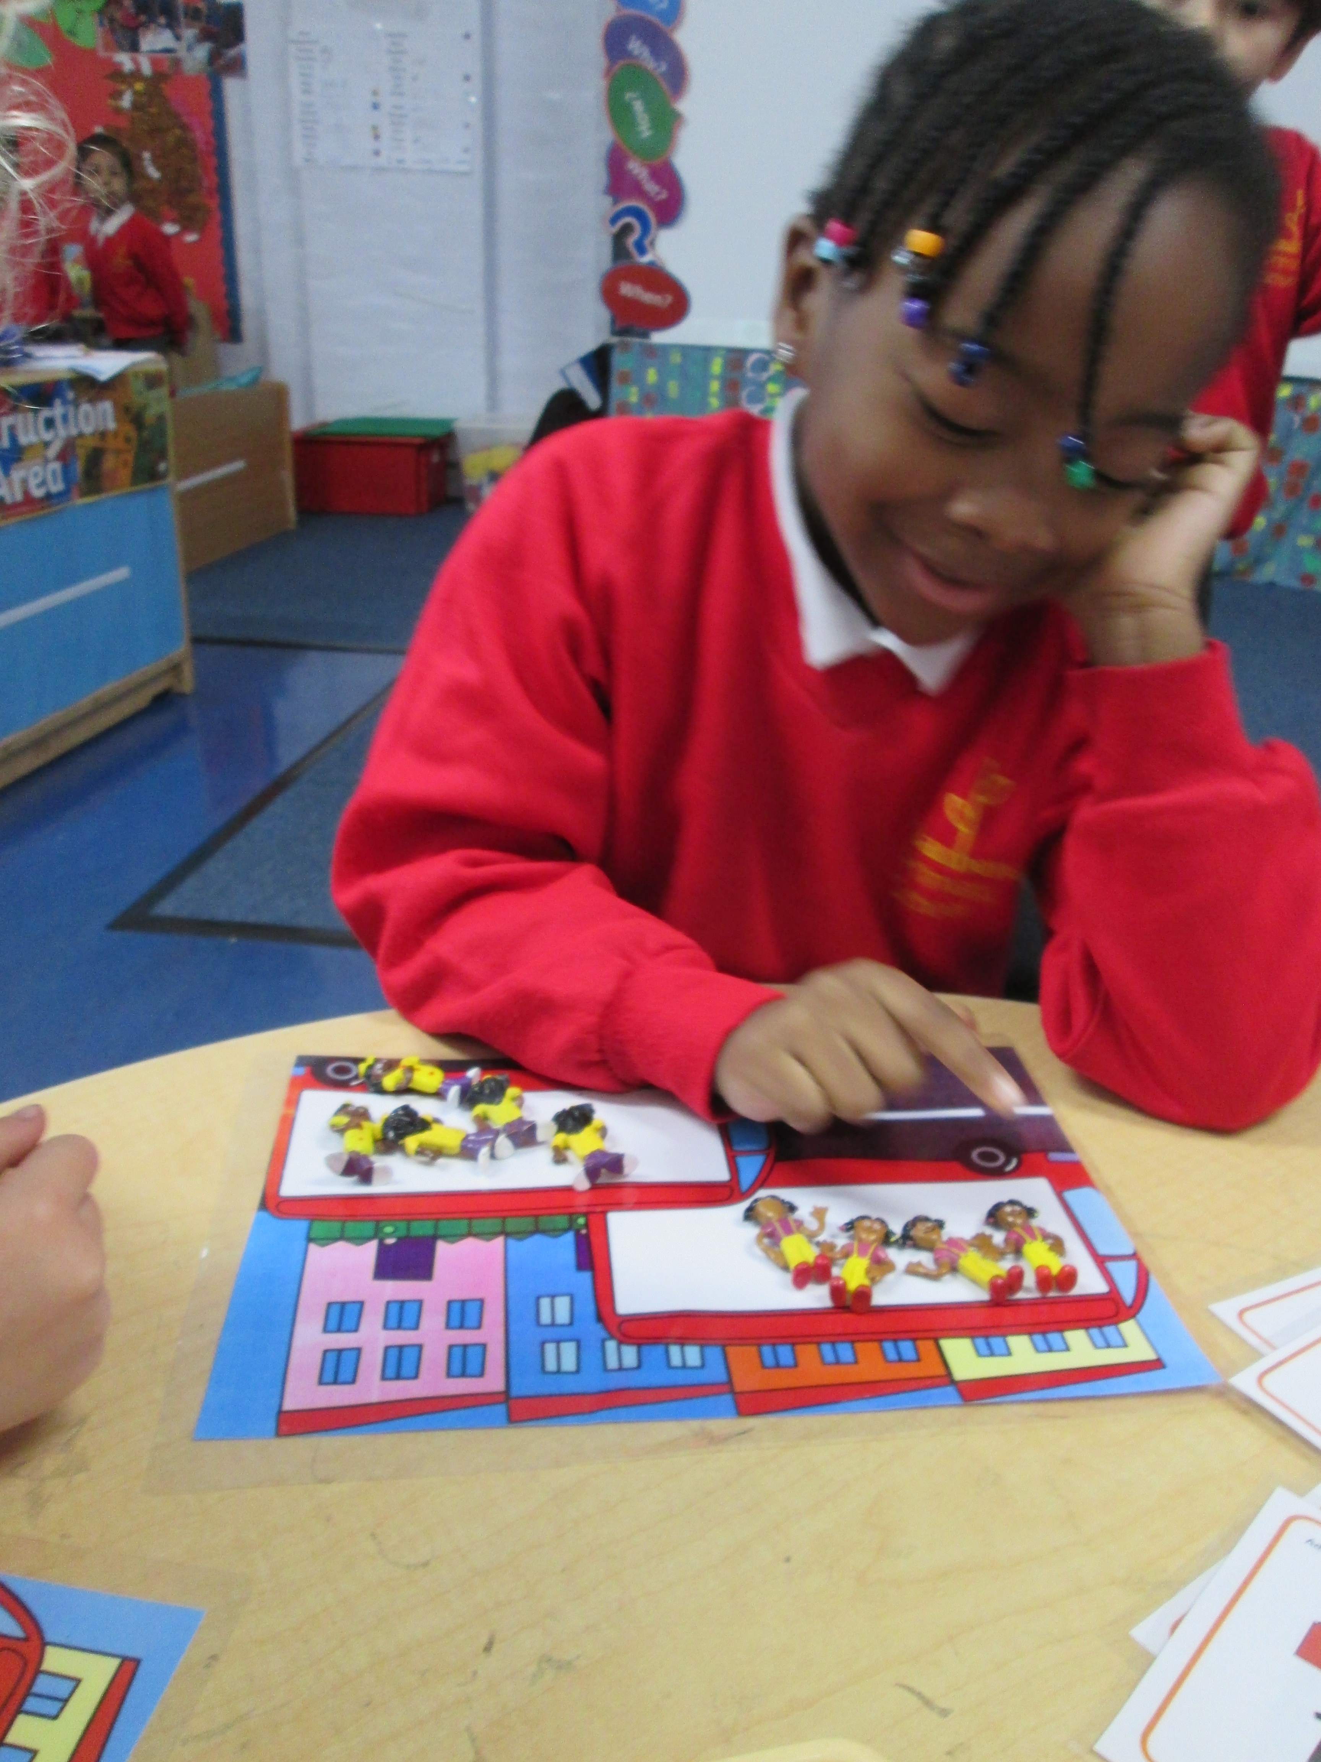
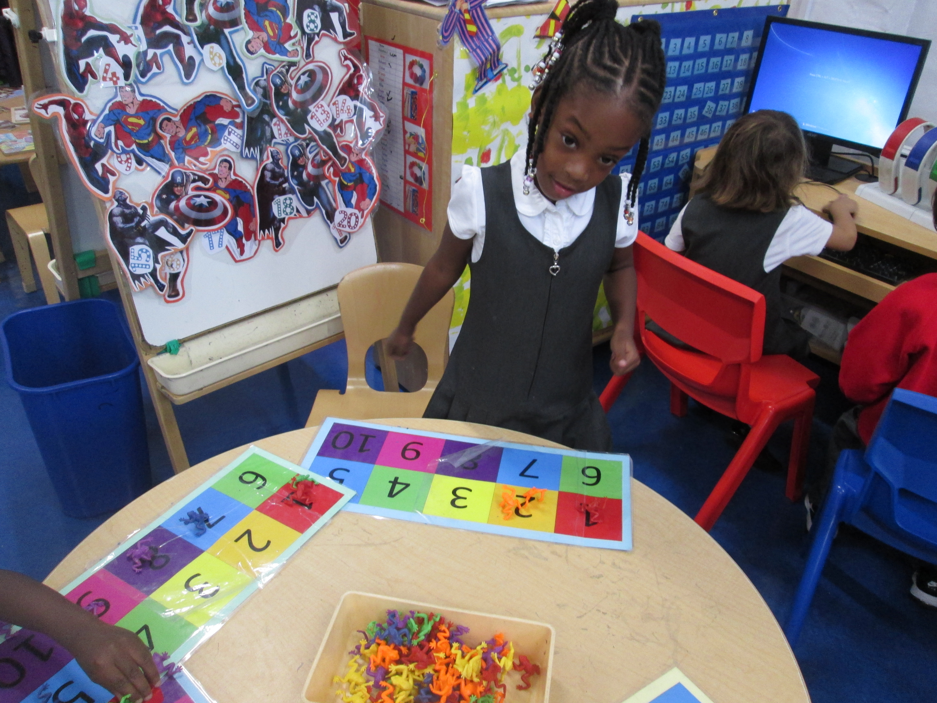
What does MATHS look like in the Early Years at Daubeney?

Slide 5
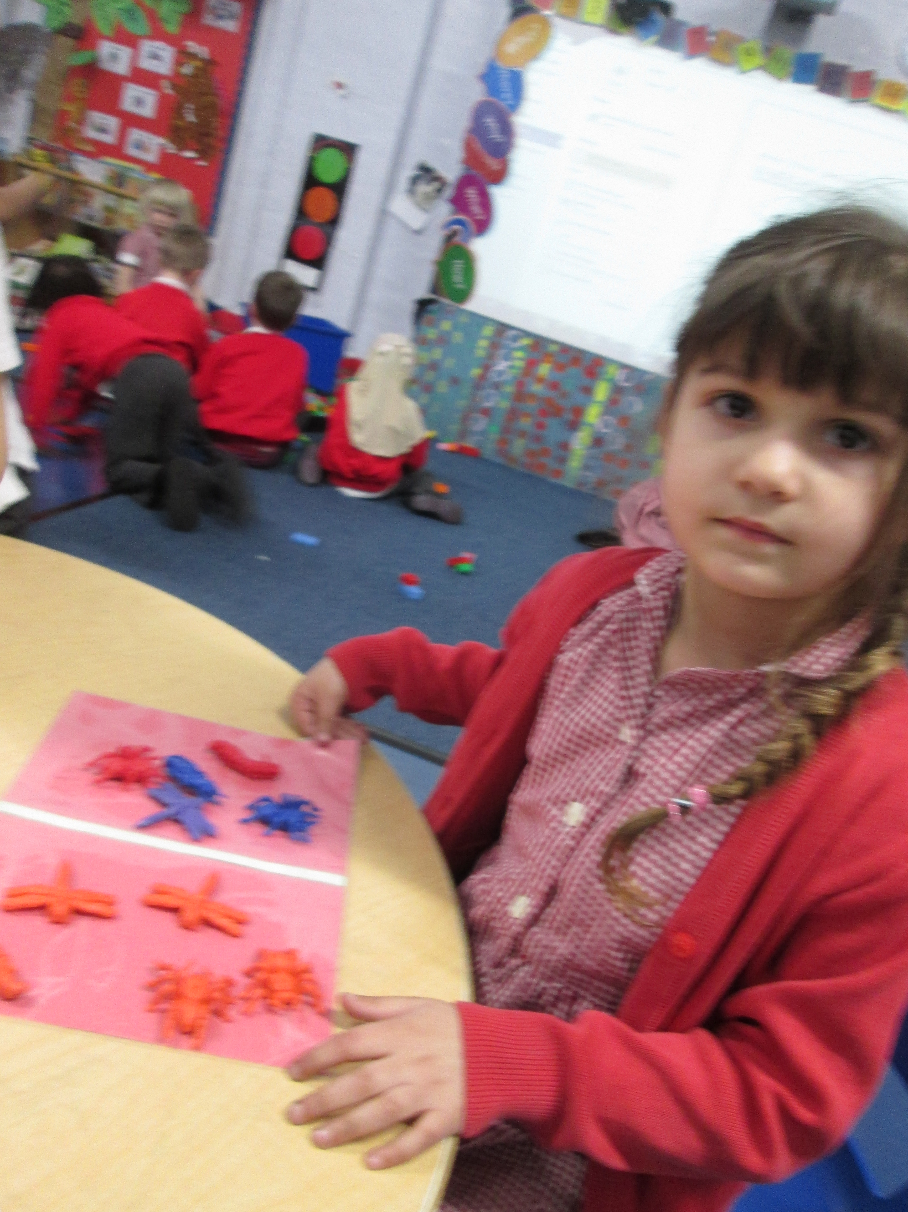
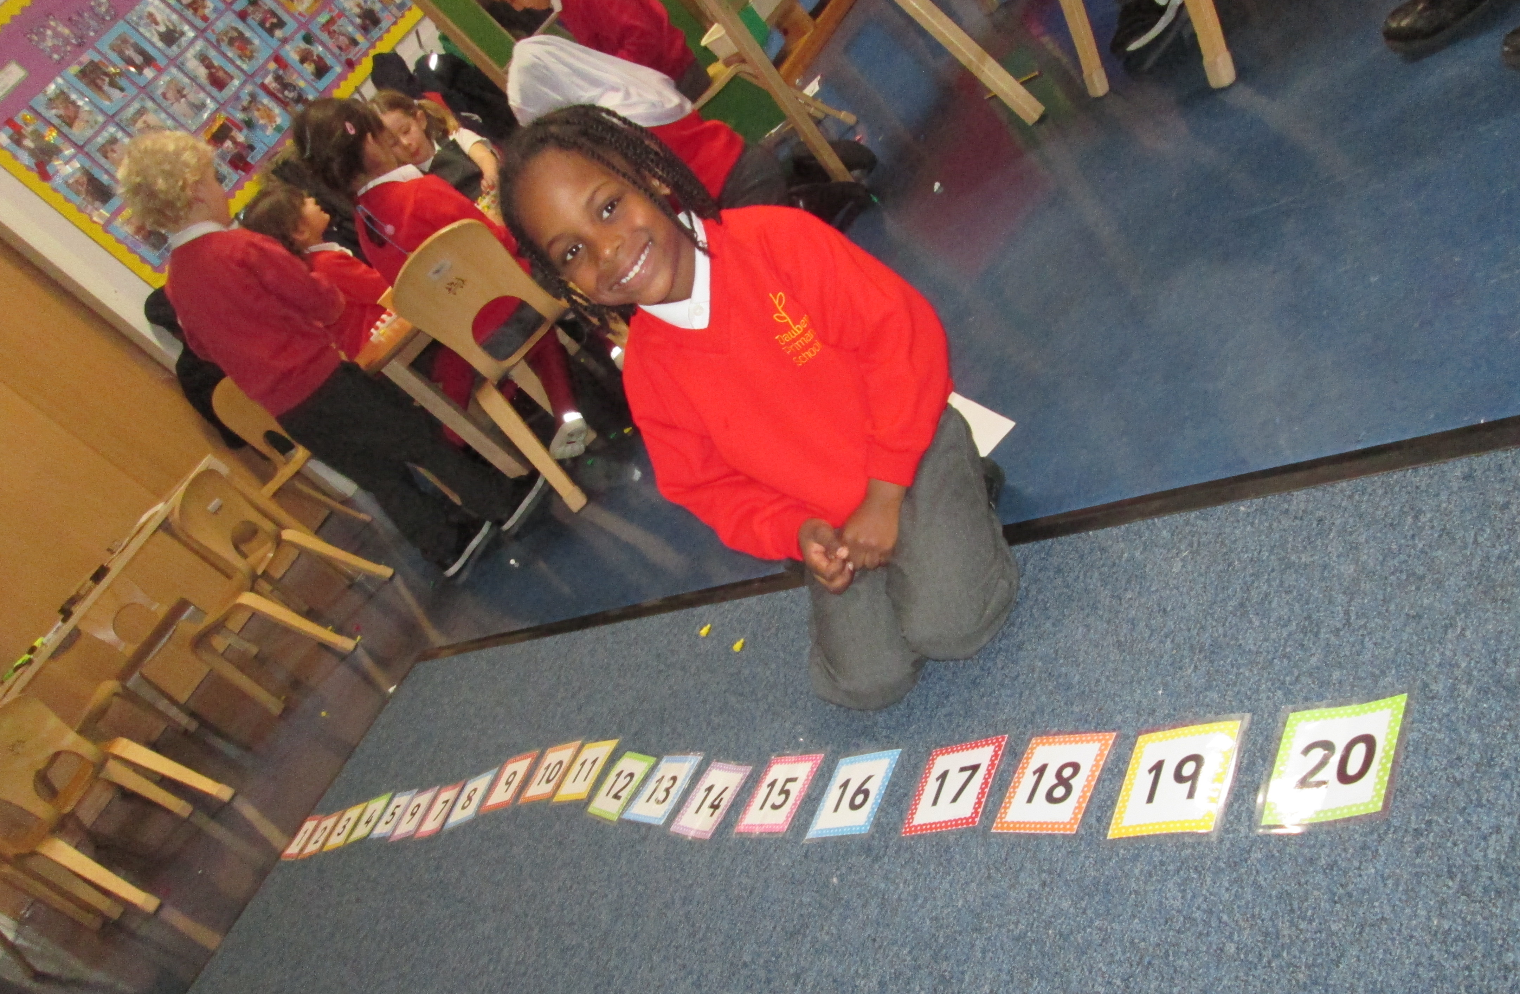
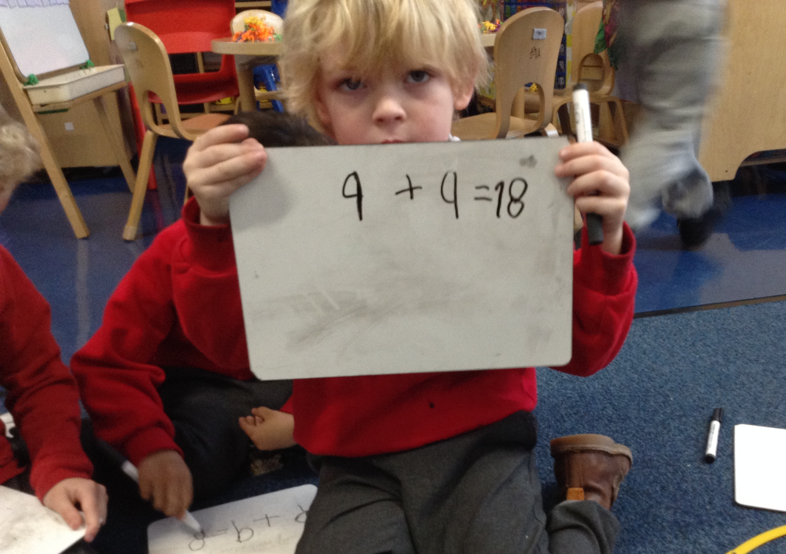
What your children have gained:
Number Sense Hands on activities
Visual Cues Building Bridges
Making the connections Building mental imagery
Developing Meaning A positive attitude

Slide 6
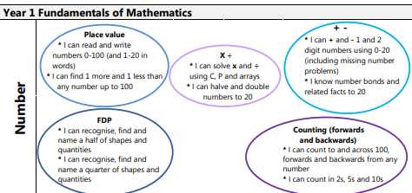

Slide 7
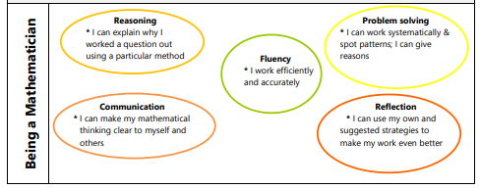

Slide 8
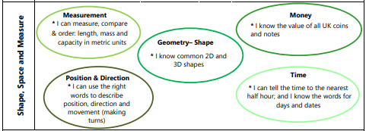

Slide 9
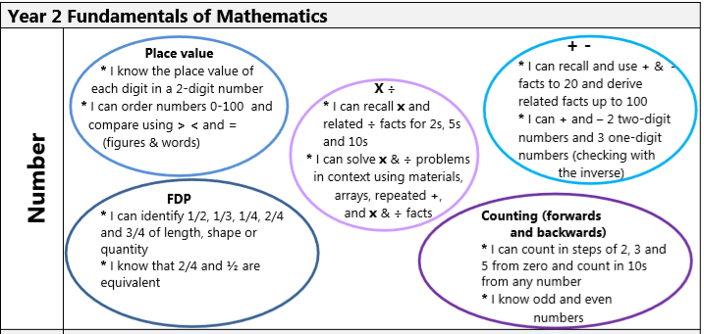

Slide 10
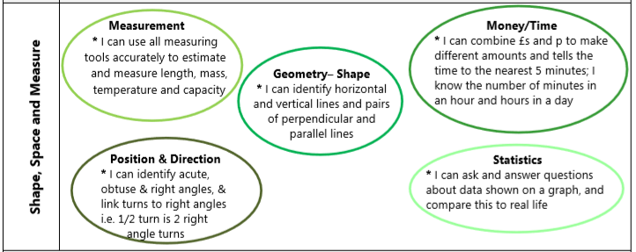

Slide 11
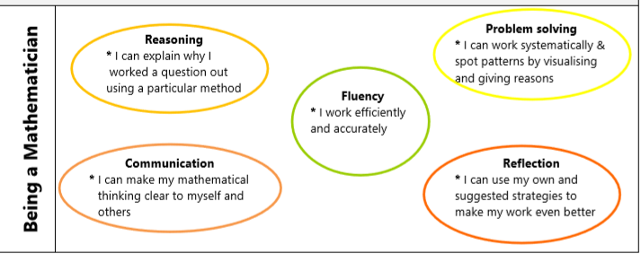

Slide 12
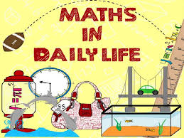


MATHS IS ALL AROUND US IN EVERYTHING WE DO
CHALLENGE!

Slide 13

Counting
Television
Shows /Movies
Playing board games.
Telling time
MATHS is everywhere!
Number / Shape hunt
Riding a bike/
Driving
Measuring
distance
Measuring ingredients
CCC
Sharing food
Shopping
Tidying up
Brushing you teeth
Pattern
Hunt
Sequencing objects
Sorting laundry

Slide 14

ACTIVITY

Slide 15


